Slide 1
Virtual Painter using OpenCV
Aniket Rawat 211315
Himanshu Sharma 211321
Submitted to:
Dr. Sahil Sharma
Assistant Professor, Dept. of CS&IT, JUIT, Waknaghat

Slide 2
AGENDA
Introduction
Problem Statement
Aims and Objectives
Technology Stack
Significance of the Project
Project Features
Practical Demo
GitHub Link

Slide 3
INTRODUCTION
Virtual Paint is a CPP program that uses OpenCV to perform video processing through a webcam. The video shows colored points according to color on the video.
The аlgоrithm is simрly printing the соlоred роints оn videо ассоrding tо the соlоr оn the videо, these соlоred роints аre stоred in а veсtоr ассording tо their роsitiоn. The videо is stоred аs а sequenсe оf imаges.

Slide 4
PROBLEM STATEMENT
To develop a virtual painting application, using the techniques of OpenCV, which can draw anything on any surface by just capturing the motion of a colored marker with a camera.
The camera must detect only the images of the given color (here, red, green and blue) and discard the images of any other color.

Slide 5
AIMS AND OBJECTIVES
Our project aims to create a virtual paint application where the drawing happens in air as the gestures are recognized by the system. A real time image is detected which is colored when captured by web camera.
We create a virtual paint application same as MS Paint by using user interface libraries then this paint application is controlled by gestures. Gesture are recognized and then action is performed based on that gesture.

Slide 6
TECHNOLOGY STACK

Slide 7
SIGNIFICANCE OF THE PROJECT
This gadget is capable of tough traditional writing strategies. It gets rid of the want to hold a cell telephone in hand to take notes, offering a easy manner to do the identical. The last intention is to create a computer imaginative and prescient device studying application that promotes human-computer interaction (HCI) which refers to the connection between humans and the PC or particularly the gadget. This undertaking allows the client to have interactive surroundings in which the customer can draw some thing he goals by the usage of given colors.

Slide 8
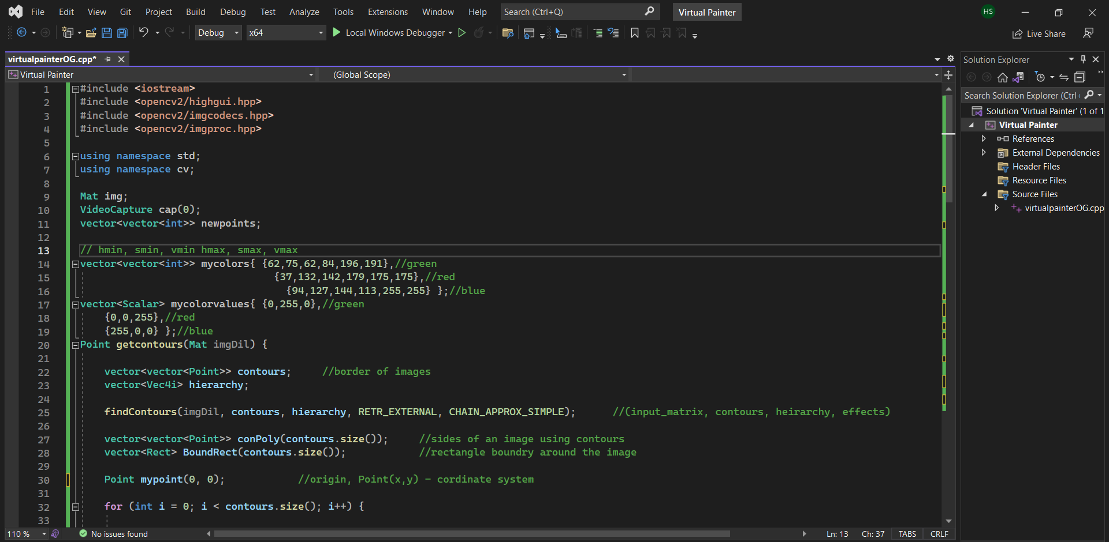
PROJECT FEATURES

Slide 9
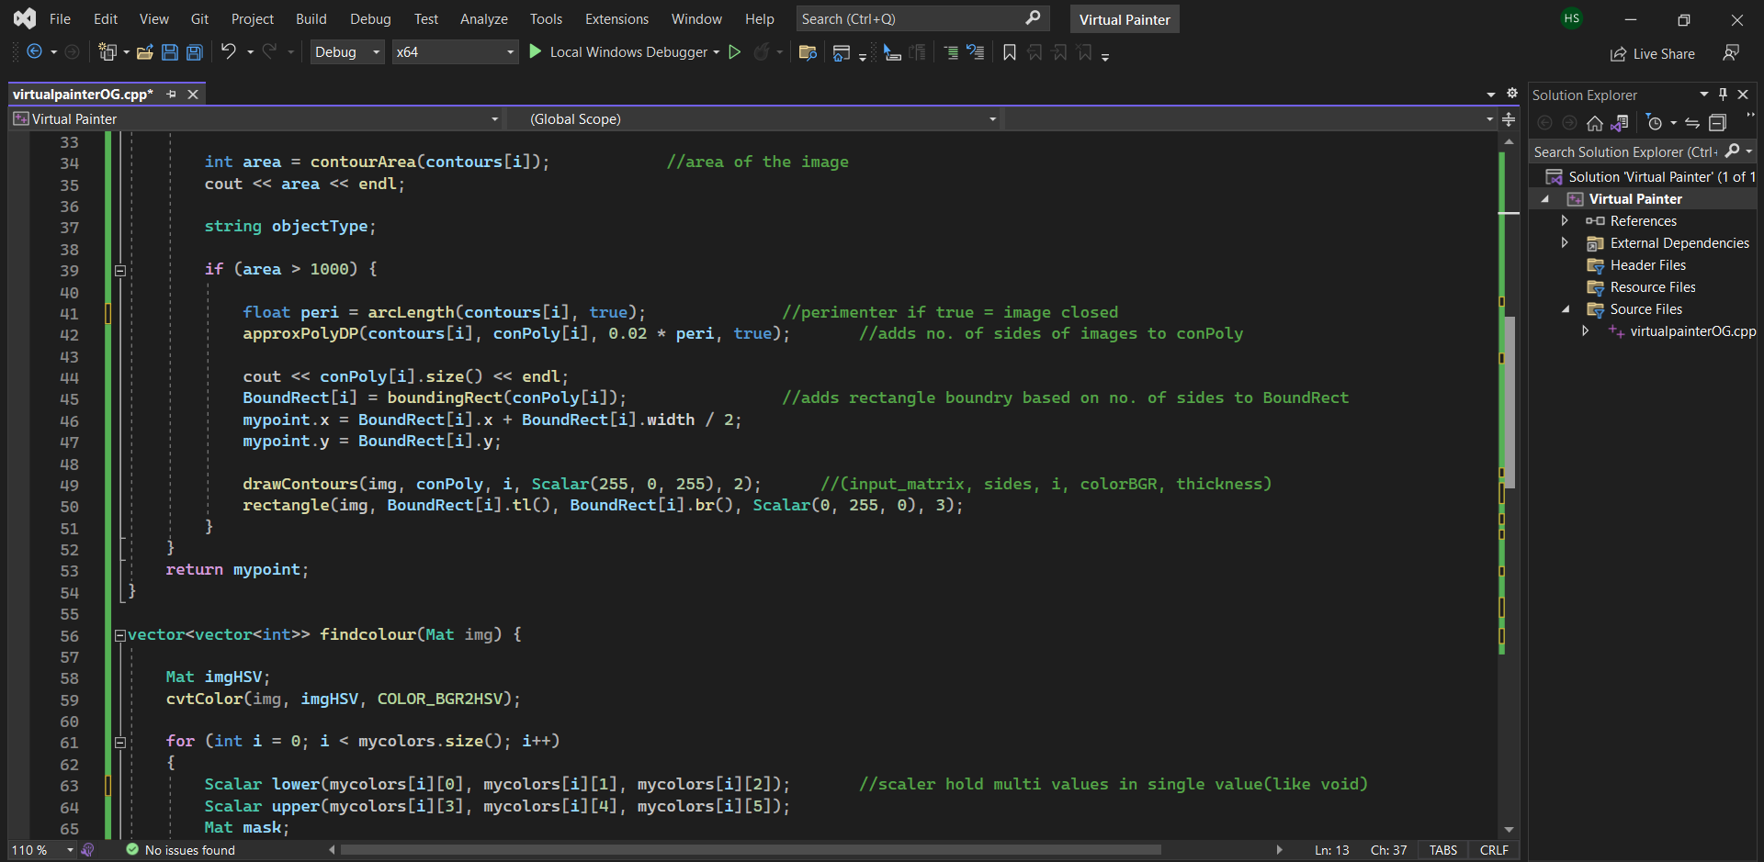

Slide 10
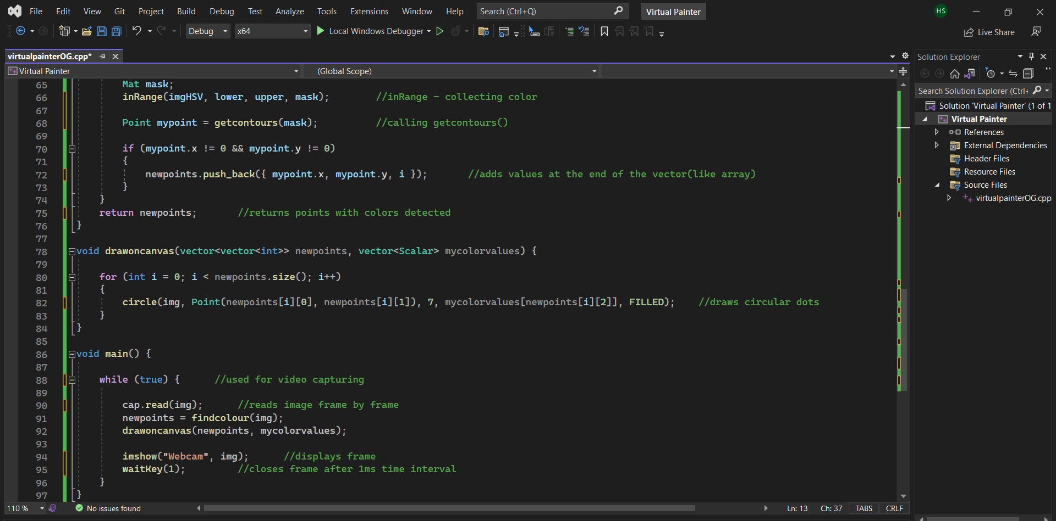

Slide 11
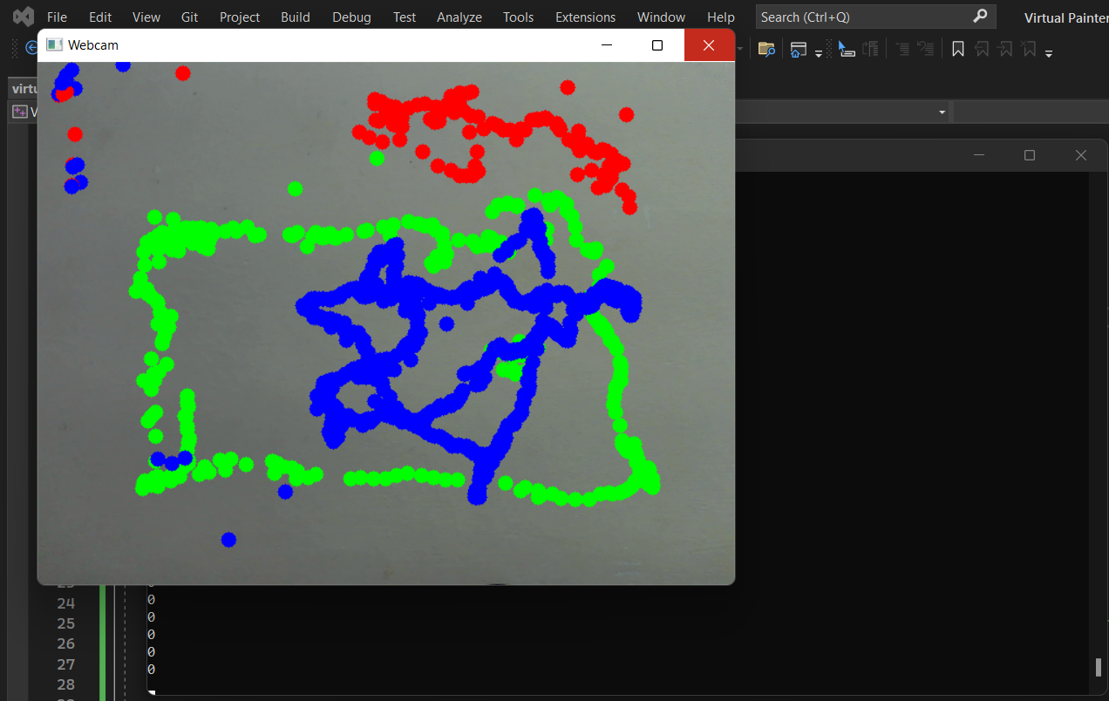
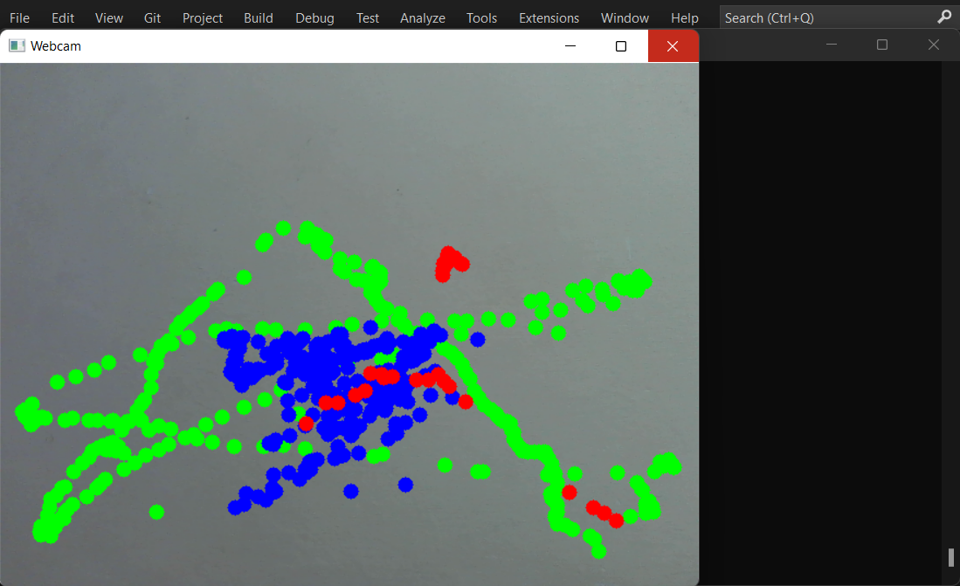
PROJECT DEMO

Slide 12
GITHUB LINK
https://github.com/anirowot/Virtual-Painter-Cpp-and-OpenCV.git

Slide 13


